Slide 1






MANAGING DIGITAL BUSINESSES AND MARKETS
Sushil Satish Kogta
Pratik Pandey
Pooja Datre
Hao Tun Kao
Arjun Bajpai
Sec. 501 Group 2 Presentation : Netflix
BUDT 758G
October 2019

Slide 2
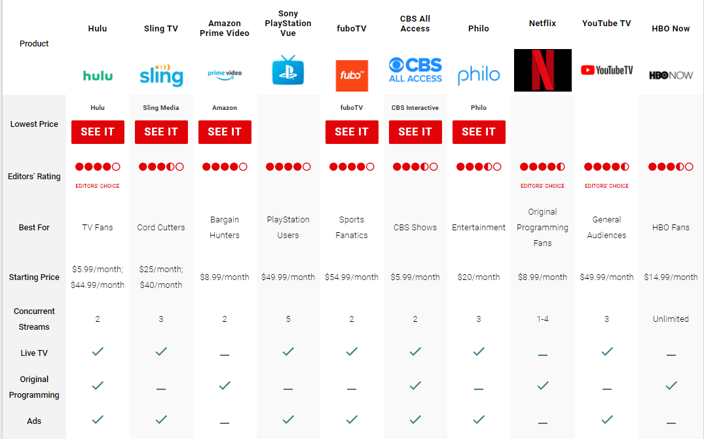
Streaming media market overview
Netflix - Q3 2018
Net profit: $ 403 mn | Users: 137.1 mn.
Sources : https://www.pcmag.com/roundup/336650/the-best-video-streaming-services
https://www.meldium.com/size-of-the-video-streaming-industry-market/
https://www.businessofapps.com/data/netflix-statistics/

Slide 3

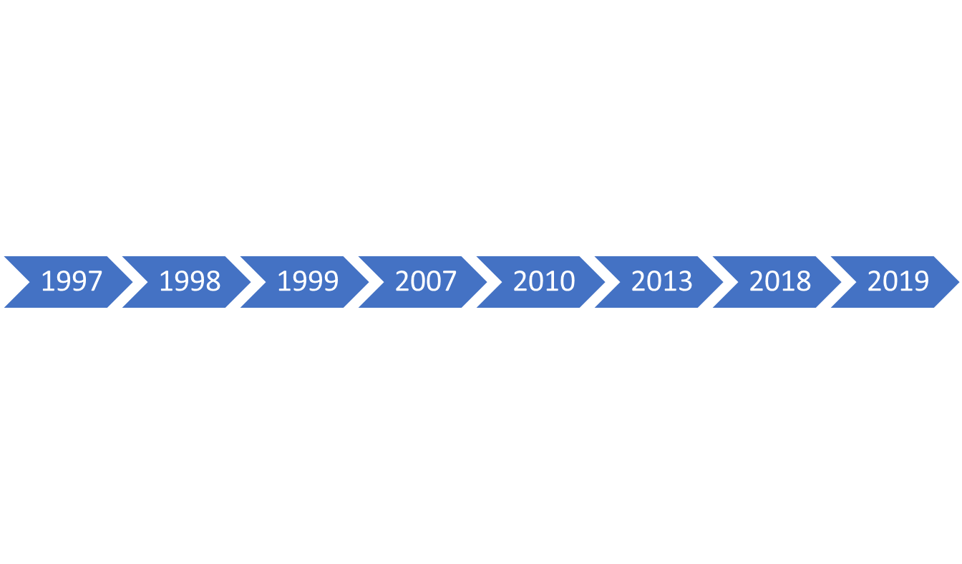

Brief Overview
Timeline of Netflix
Sources: https://media.netflix.com/en/about-netflix
https://logos.fandom.com/wiki/Netflix

Slide 4
Netflix Business Model
Operation
Customer Base
Revenue Sources
Products

Slide 5

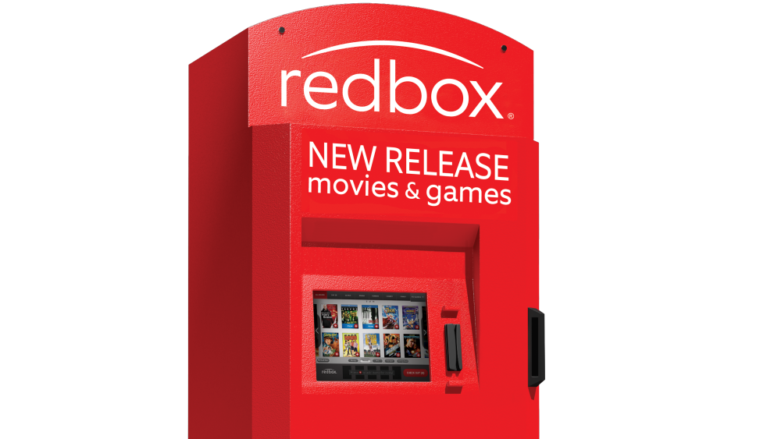
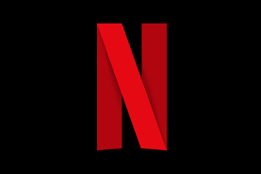

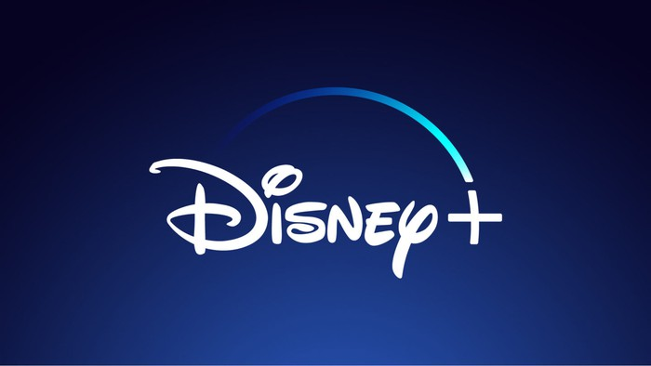



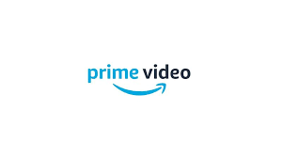
Before Netflix…..
Blockbuster tries to compete with Redbox kiosks in 2009.
Founded in 2002,
Purchased Blockbuster’s DVD Rental Business in 2012.
Netflix was founded in 1997.
Declined to purchase Netflix in 2000 for $50 million.
$1 billion in debt, delisted from NYSE in 2010.
1985
2004
2012
November 2013, announcement of closing 300 stores.
Launched website to public in 2008.
Dual revenue stream, from subscribers and advertisers..
2013
2013
Sources:https://www.investopedia.com/articles/investing/092414/economics-hulu-netflix-redbox-and-blockbuster.asp
https://www.topaccountingdegrees.org/netflix-vs-blockbuster/
https://www.consumerreports.org/streaming-media-devices/new-streaming-video-services-to-check-out/

Slide 6
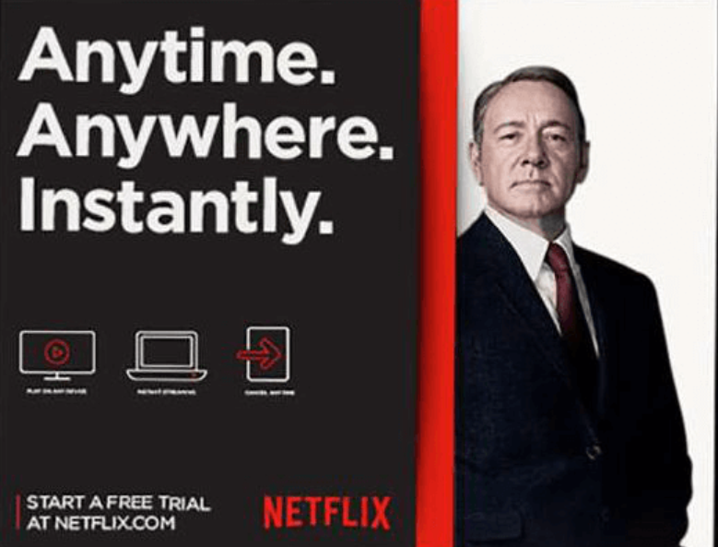
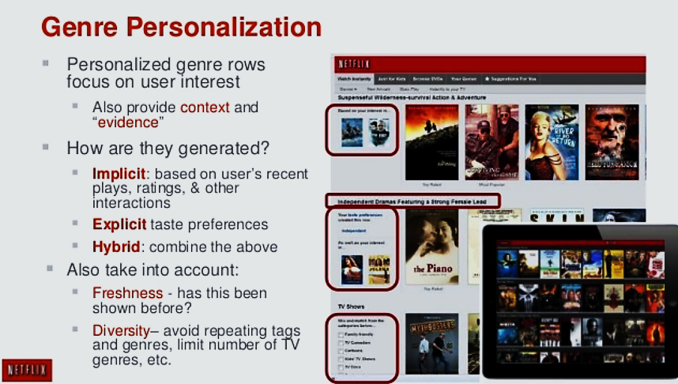
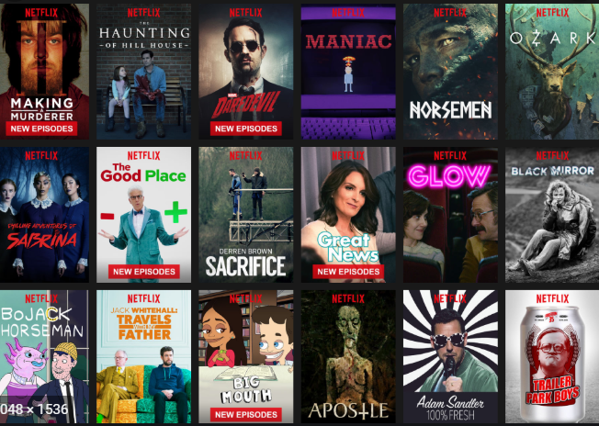
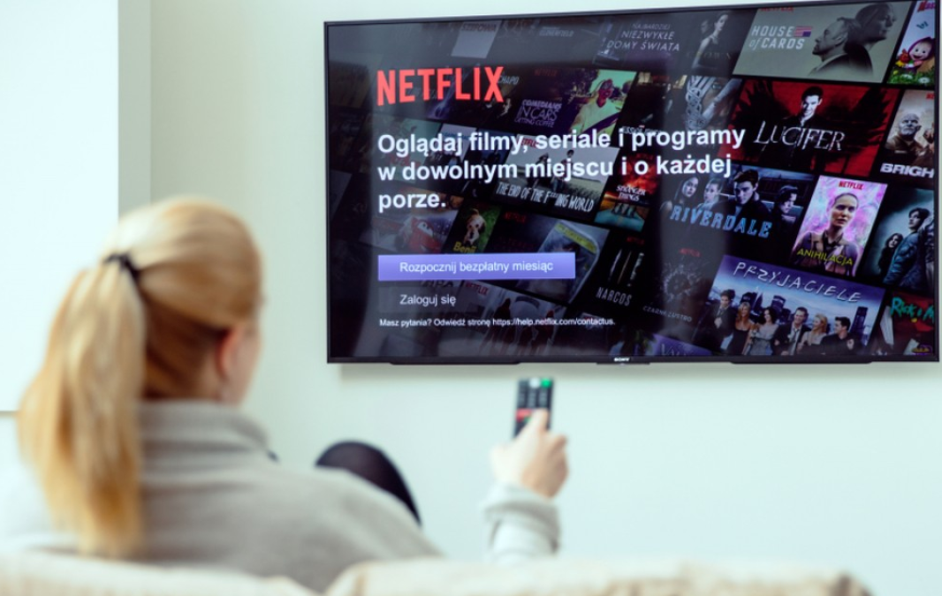
Netflix : Creative Destruction
Flat-fee
unlimited
viewing
Original contents
Commercial-free
NETFLIX
Personalized
Recommendation
engine
Video-on-demand
Any screen
at any time

Slide 7
Netflix : Challenges
Quick overview of financials
Although Netflix’s net profit and revenue increased from 2016 to 2018, the cash deficits from operating activities is expanding.
The inconsistent trends of net profit and net operating cashflow are because contents can be amortized over years.
In other words, from a cash-basis perspective, Netflix is not making money from operating activities in recent years.
[Please see next page for further details]

Slide 8
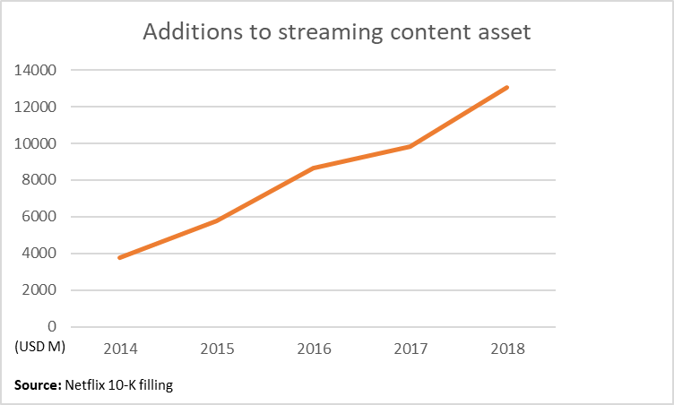
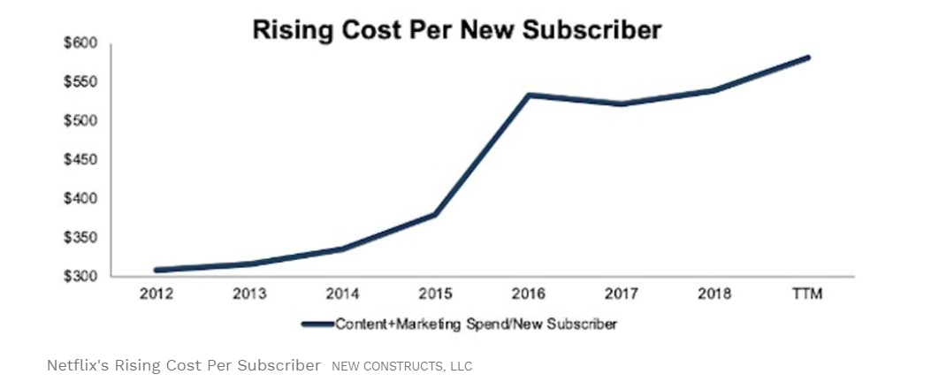
Netflix : Challenges (Cont’d)
Soaring spending on contents
The reason for deficits from operating cashflows is because Netflix is spending huge money on acquiring and producing streaming content which increased from USD3.7b in 2014 to USD13.0b in 2018.
The soaring cost on contents leads to rising cost per new subscriber.
The increasing trend of cost may also impact Netflix’s future pricing strategy.
[Please see next page for further details]
Source: Forbes

Slide 9
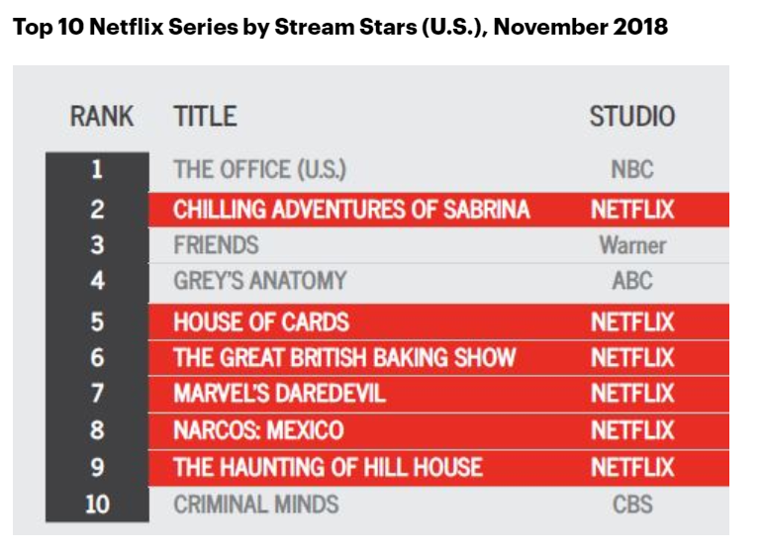
Netflix : Challenges (Cont’d)
Why doing original contents?
In 2018, 4 of Netflix’s top10 titles belong to other studios. Some of these studios (e.g. Warner) will have their own platform or corporate with other platforms.
In a nutshell, in order to beat other competitors, Netflix aims to increase their owned original contents and this strategy is changing Netflix’s cost structure.
Consumer retention and future financial performances under this strategy are still needed to be observed.
Source: https://variety.com/2018/digital/news/netflix-original-series-licensed-viewing-friends-the-office-1203085230/

Slide 10
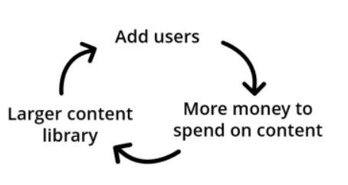
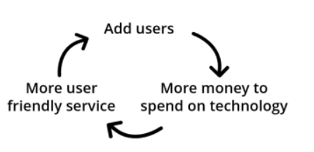
Value creation on both sides.
Initially concentrated on customer interest rather than trying to maximize their own profits.
Made it accessible to watch video anytime anywhere.
Fast growing content library attracts more audience.
Number of content producers increased as audience base increased: Cross sided network effect.
Sources : https://traviswiedower.com

Slide 11
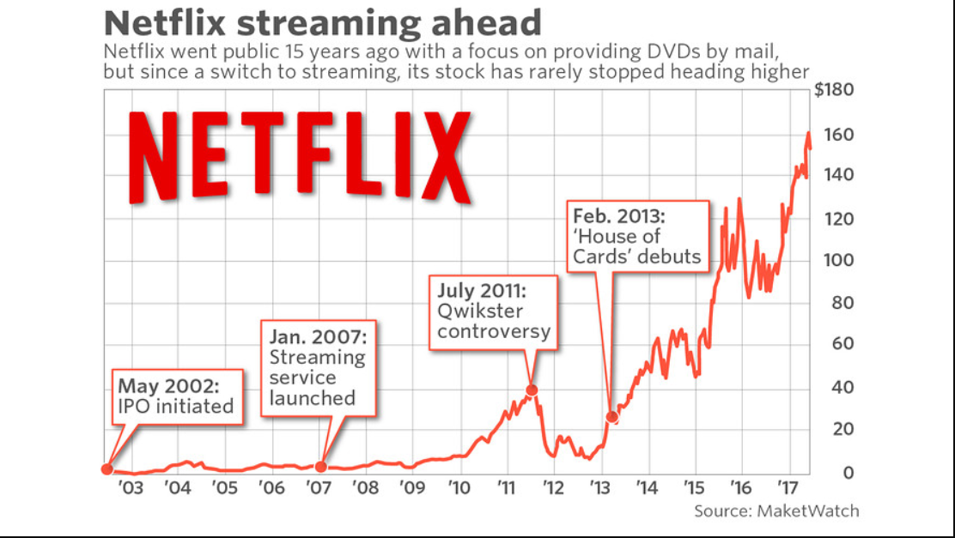
How did Netflix get big fast?
At the beginning, more convenient for the customers to receive DVDs at home.
However DVD rentals were used just to get a toehold in the highly competitive market.
Switch to streaming was met with skepticism but it was the right move for the future.
Few others saw streaming video as an option due to low customer demand.
Hence, little to no competition helped Netflix become big.

Slide 12

Basic
Standard
Premium
Sources: https://www.netflix.com/

Slide 13
Pricing Strategy
(DVD plan)
Standard
Premier
Sources: https://dvd.netflix.com/?dsrc=ADW13&gclid=Cj0KCQjwivbsBRDsARIsADyISJ8q9OCy0nenk-Hd3aykqmjixS_kFhY6xSQVkw4vz1jtdXjaQMc9DP4aAiYgEALw_wcB

Slide 14
Consumer behaviors BEFORE Netflix entered the market
Blockbuster.
Movies, rented VHS tapes or DVDs and live TV.
Once a week episodes→ people →accepting of ads on TVs ¹
Consumers even used to pay for content they didn’t watch.

Slide 15
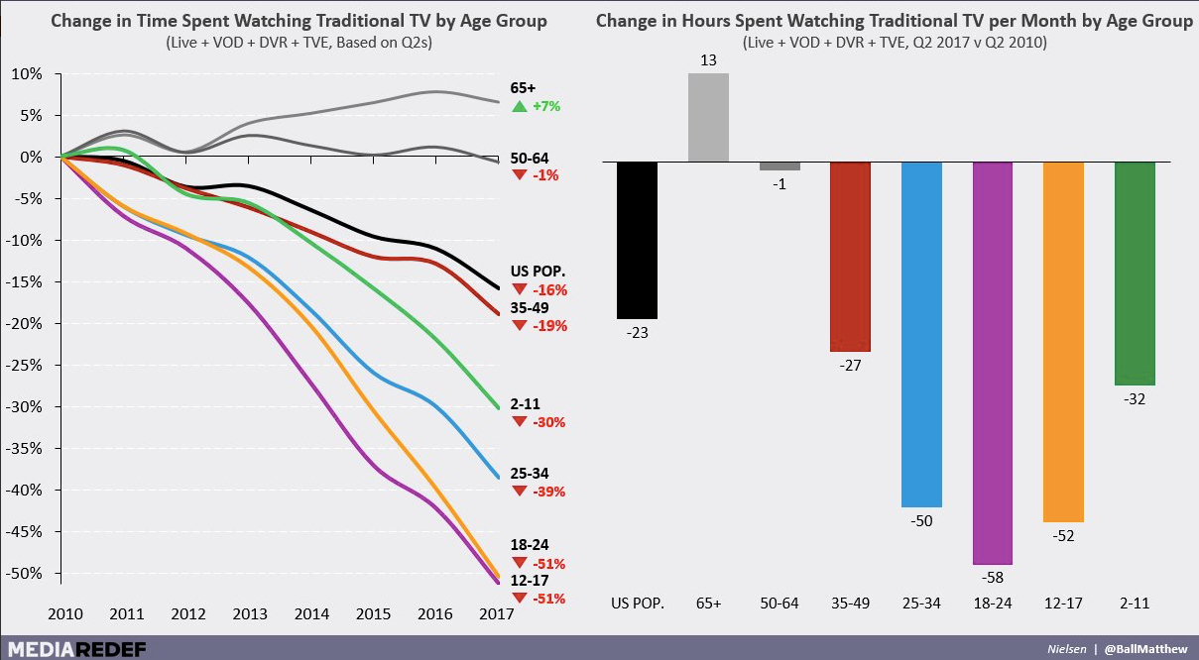
Consumer behaviors AFTER Netflix entered the market
₂
No longer tied to the TV and forced to sit through commercials.
Cord-cutting
Consumers have flexibility. ³
Binge-watching

Slide 16
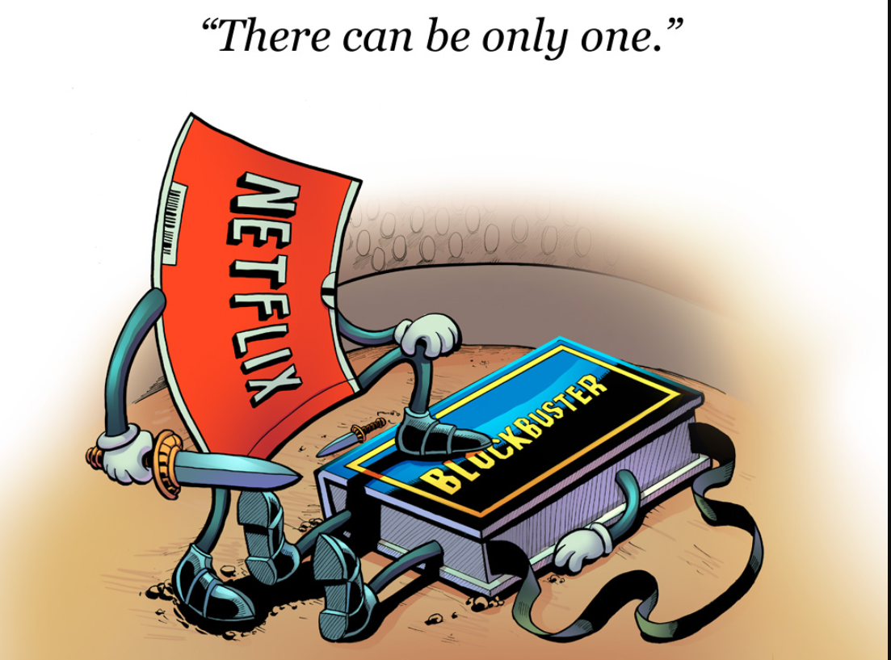
Main Competition
Sources :www.nerdappropriate.com/

Slide 17
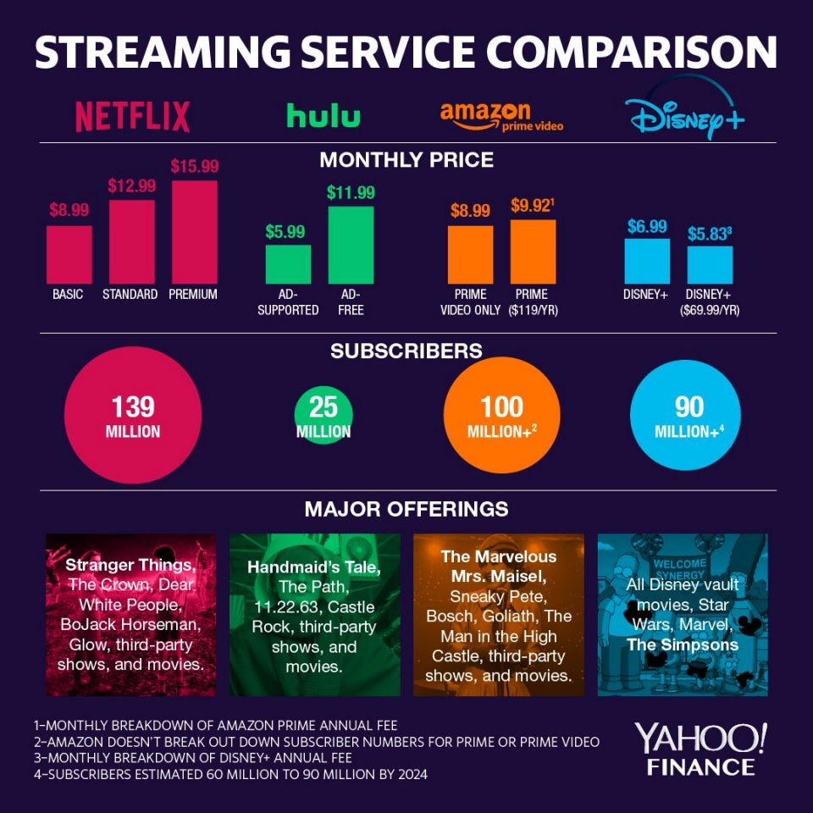
Main Competition
Sources : Yahoo Finance

Slide 18
Market’s future development
Media giants like Disney and WarnerMedia are going to enter the market but won’t rely on people cancelling their Netflix subscriptions
Popular library of content.
Investing in new content →Pulling some content back from Netflix.
Examples?
AI, augmented reality is on the up and trying to disrupt the Netflix wave.

Slide 19
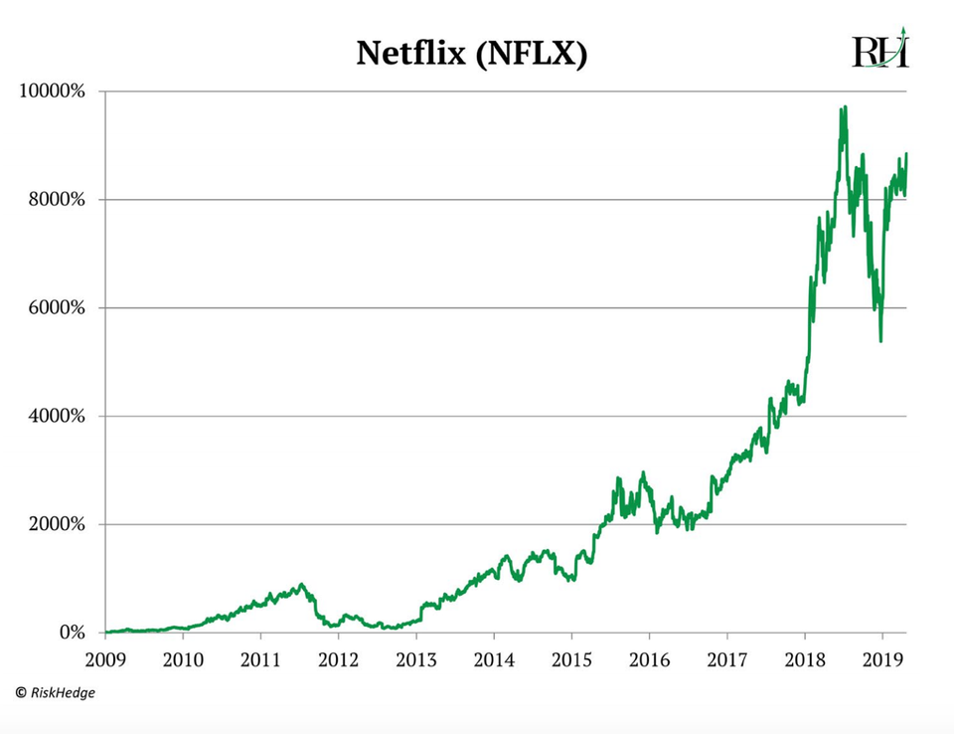
Netflix’s next step
Netflix has been preparing for the influx of competition
₅
Original content is king
Loyal consumer base
Easy to use
To Have Ads, Or Not To
Have Ads?
Cost: How high? ⁶

Slide 20
Sources
https://www.forbes.com/sites/blakemorgan/2019/02/19/what-is-the-netflix-effect/#1d35fa665640
https://intrinsicinvesting.com/2018/07/20/netflix-and-rise-of-global-scale-media
https://www.forbes.com/sites/blakemorgan/2019/02/19/what-is-the-netflix-effect/#72a962945640
https://adage.com/article/special-report-digital-alist-2010/digital-a-list-2010-netflix-consumer-behavior/142199
https://www.forbes.com/sites/stephenmcbride1/2019/05/21/netflix-has-175-days-left-to-pull-off-a-miracle-or-its-all-over/#2b737d2675c4
https://www.forbes.com/sites/danafeldman/2019/07/15/the-future-of-netflix-is-it-really-as-doom-and-gloom-as-people-are-saying/#a7ffdcb66828
BUDT 758G
MANAGING DIGITAL BUSINESSES AND MARKETS
Sec. 501: Group 2 Presentation

